Slide 1


Slide 2
Joins
Correlating Tables with Foreign Keys

Slide 3
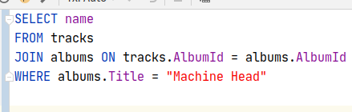
Last Lecture
Recall in the last lecture we learned about sub-queries
Sub-queries could be be used to answer questions like “Give me the name of all tracks on the album named ‘Machine Head’”
Notes:
Can be found online… but I can’t link to it

Slide 4
Joins
While Sub-Queries are useful and used in production environments, this is a common operation that is typically and more efficiently achieved with JOINS
Notes:
Can be found online… but I can’t link to it

Slide 5
Joins
The basic join syntax is SELECT <cols> FROM <table name> JOIN <table name> ON <condition> WHERE <predicates>
Notes:
Can be found online… but I can’t link to it

Slide 6
Joins
This example shows what is called an Inner Join
An inner join returns all rows for which the condition in the join clause is true
Notes:
Can be found online… but I can’t link to it

Slide 7
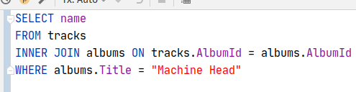
Joins
Can also be written out explicitly with an INNER keyword
Inner joins are the most common sort of join you will work with
Notes:
Can be found online… but I can’t link to it

Slide 8
Joins
Note that the join condition uses the Foreign Key in tracks and the key in albums
The join condition is usually an equality condition, but it doesn’t have to be
Notes:
Can be found online… but I can’t link to it

Slide 9
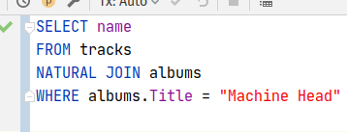
Natural Joins
It is often the case that the columns in one table line up with the columns on another table
FKs typically have the same name as the referred table
If this is the case, you can use a natural join and omit the equality expression
Notes:
Can be found online… but I can’t link to it

Slide 10
Natural Joins
A little cleaner
Rare in practice
Why?
Notes:
Can be found online… but I can’t link to it

Slide 11
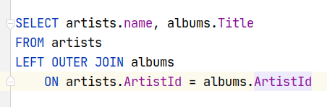
Outer Join
Inner joins are fairly intuitive
But sometimes you want ALL the rows of a table, even if there isn’t a match in the joined table
To accomplish this we need to use OUTER JOINs
Notes:
Can be found online… but I can’t link to it

Slide 12
Outer Join
Note that I am selecting values from both the artists as well as the albums table
This query will return all artist/album combinations as well as artists who have no albums, with the album value set to null
Notes:
Can be found online… but I can’t link to it

Slide 13
Outer Join
If I changed this to an inner join, artists who had no albums would be excluded from the results
Notes:
Can be found online… but I can’t link to it

Slide 14
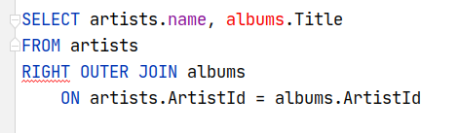
Outer Join
We could change this to a RIGHT OUTER JOIN to include nulls from the right table (in this case albums)
The artists table is considered “left” of the albums table
Hence LEFT OUTER JOIN
Notes:
Can be found online… but I can’t link to it

Slide 15
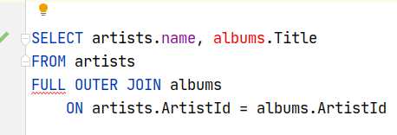
Outer Join
And, finally, we could use a FULL OUTER JOIN to include null values from both tables
Notes:
Can be found online… but I can’t link to it

Slide 16
Outer Join
As you might have noticed, SQLite does not support Right Outer Joins or Full Outer Joins
In practice, Outer Joins are rare, and Right and Full outer joins are even rarer
Notes:
Can be found online… but I can’t link to it

Slide 17
Self Joins
Chinook DB has a self-referential table in it
Employees have a reference to their boss via the ReportTo foriegn key
How do we deal with that?
Notes:
Can be found online… but I can’t link to it

Slide 18
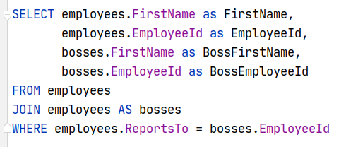
Self Joins
It’s pretty much the same technique using a JOIN
However, you need to alias the table to a new name
And you need to disambiguate the column names
Both of these use the “as” syntax
Notes:
Can be found online… but I can’t link to it

Slide 19
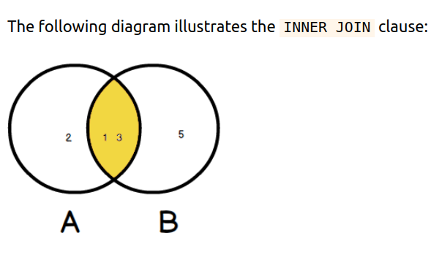
Joins As Venn Diagrams
One way to think about the types of joins is to use a ven diagram
Inner Joins are the intersection of the two relational sets
Notes:
Can be found online… but I can’t link to it

Slide 20
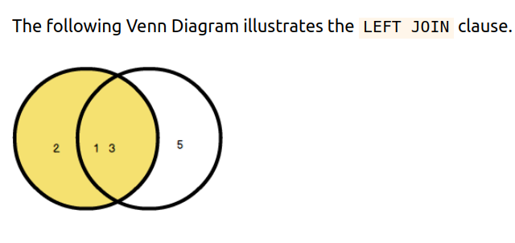
Joins As Venn Diagrams
Left Joins are all the left table and whatever matches in the right table
Notes:
Can be found online… but I can’t link to it

Slide 21
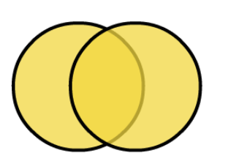
Joins As Venn Diagrams
And Full Outer Joins include all rows from all tables
I personally find it easier to just think in terms of nulls in the join condition:
Inner - ignore nulls
Outer - keep nulls
Notes:
Can be found online… but I can’t link to it

Slide 22

More Exotic Joins
There are some more exotic joins, such as the cross join
This creates all possible combinations of album rows and artist rows
I have never used it, but I can imagine uses for it
Notes:
Can be found online… but I can’t link to it

Slide 23
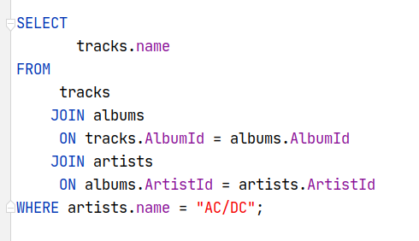
Joining Multiple Tables
Sometimes you need to join across multiple tables to get what you want “Give me the name of all tracks by AC/DC”
Notes:
Can be found online… but I can’t link to it

Slide 24
Joining Multiple Tables
Column naming can get tricky when you are joining multiple table
You may have to use aliasing to get exactly what you want
Notes:
Can be found online… but I can’t link to it

Slide 25
Joins Summary
Joins are a way to correlate data across tables
There are a few different types of joins
Inner joins are the most common
A table with an FK to itself can be joined by aliasing the table in the join clause
You can disambiguate table and column names using the AS keyword
Joining across multiple tables involves multiple JOIN clauses

